Slide 1
COMP 302
Git Tutorial

Slide 2


What is Git?
A tool for tracking changes in your project files.

Slide 3

What can Git do?
Keep track of changes in your code
int a = 5;
int a = 5;
Int b = 6
int a = 1;
Int b = 6
Create a file
Add a line
Change a line

Slide 4
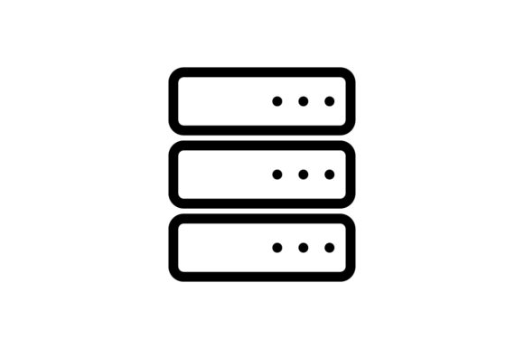

What can Git do?
Synchronizes code between contributors
Int a = 5
Gitlab Servers
Collaborator 1
Collaborator 2
Int a = 5
Int a = 5

Slide 5
What can Git do?
Test changes without losing the original
int a = 5;
int a = 5;
doStuff()
Works well
int a = 5;
doStuff()

Slide 6
What can Git do?
Test changes without losing the original
int a = 5;
int a = 5;
int a = 5;
doStuff()
Doesn’t work

Slide 7
What can Git do?
Revert back to old versions of code
int a = 5;
int a = 5;
Int b = 6
int a = 1;
Int b = 6
Create a file
Add a line
Change a line

Slide 8
What can Git do?
Revert back to old versions of code
int a = 5;
int a = 5;
Int b = 6
Create a file
Add a line

Slide 9
What can Git do?
Summary
Keeps track of changes in your code.
Synchronizes code between collaborators
Test changes to code without losing original
Revert back to old versions of your code

Slide 10
Installing Git
Visit this website and follow the instructions:
Download Git

Slide 11
Structure of Git Workflow
Working Directory
Staging Area
Repository
commit 1
commit 2
git add
git commit
commit 3
commit 4
This is happening on your local computer

Slide 12



Structure of Git Workflow
Local Repository
commit 1
commit 2
commit 3
commit 4
Now you are pushing it to the cloud

Slide 13
Generating a SSH Key
You need a SSH Key to communicate with GitLab for security purposes.
Open your terminal (Git Bash for Windows)
ssh-keygen -t ed25519
Copy your ssh key from ~/.ssh/id_ed25519.pub
Paste it to Gitlab under Settings > SSH Keys
Note: You can use an access token as an alternative but we only talk about SSH key for the sake of brevity (check: link).

Slide 14
Git Commands
A repository on Gitlab servers
git clone <url>
Copies a remote repository on your computer
Int a = 5
Int a = 5
git clone <url>
Your Computer

Slide 15
Git Commands
Repository on Gitlab servers
git add <filename>
Tells git to include the file in the next revision of the repository.
git add . adds all changed files
Int a = 5;
test.java
Int a = 5;
Int b = 6;
Int a = 5
git add test.java
Changes to be committed:
modified: test.java
My Computer

Slide 16
Git Commands
Repository on Gitlab servers
git commit –m “message”
Saves (commits) the changes to repository as a new version.
-m is used to describe the commit
Int a = 5;
test.java
Commit History
Int a = 5;
Int b = 6;
git commit –m “add b”
Int a = 5;
Int b = 6;
Int a = 5;
test.java
My Computer
Commit 1
add b

Slide 17
Git Commands
Repository on Gitlab servers
git status
Saves (commits) the changes to repository as a new version.
-m is used to describe the commit
Int a = 5;
test.java
Commit History
git status
Int a = 5;
Int b = 6;
on branch master
Your branch is ahead of ‘origin/master’ by 1 commit
Int a = 5;
My Computer
Commit 1
add b

Slide 18
Git Commands
Repository on Gitlab servers
git push <remote> <branch>
Sends committed changes to remote repository (Gitlab).
Int a = 5;
Int a = 5;
Int b = 6;
test.java
git push origin master
Int a = 5;
Int b = 6;
My Computer
test.java

Slide 19
Git Commands
Repository on Gitlab servers
git pull <remote> <branch>
Retrieves changes from remote repository (Gitlab).
Int a = 5;
Int a = 5;
Int b = 6;
Int c = 9;
test.java
Int a = 5;
Int b = 6;
git pull origin master
Int a = 5;
Int b = 6;
Int c = 9;
My Computer
test.java

Slide 20
Merge Conflicts
Repository on Gitlab servers
This occurs when two different commits can’t be automatically merged.
You need to resolve this conflict.
Int a = 5;
Int a = 5;
Int b = 6;
Int c = 9;
test.java
Int a = 5;
Int b = 6;
Int a = 5;
Int b = 6;
Int c = 9;
My Computer
test.java

Slide 21
Merge Conflicts
Repository on Gitlab servers
This occurs when two different commits can’t be automatically merged.
You need to resolve this conflict.
Int a = 5;
Int a = 5;
Int b = 6;
Int c = 7;
test.java
Int a = 5;
Int b = 6;
Int a = 5;
Int b = 6;
Int c = 9;
My Computer
test.java

Slide 22
Merge Conflicts
Repository on Gitlab servers
This occurs when two different commits can’t be automatically merged.
You need to resolve this conflict.
Int a = 5;
Int a = 5;
Int b = 6;
Int c = 7;
test.java
Int a = 5;
Int b = 6;
git commit –am “change c”
Int a = 5;
Int b = 6;
Int c = 1;
My Computer
test.java

Slide 23
Merge Conflicts
Repository on Gitlab servers
This occurs when two different commits can’t be automatically merged.
You need to resolve this conflict.
Int a = 5;
Int a = 5;
Int b = 6;
Int c = 7;
test.java
Int a = 5;
Int b = 6;
git push
Int a = 5;
Int b = 6;
Int c = 1;
Cannot push because your local repository does not contain all commits in remote repository.
My Computer
test.java

Slide 24
Merge Conflicts
Repository on Gitlab servers
This occurs when two different commits can’t be automatically merged.
You need to resolve this conflict.
Int a = 5;
Int a = 5;
Int b = 6;
Int c = 7;
test.java
Int a = 5;
Int b = 6;
git pull
Int a = 5;
Int b = 6;
Int c = 1;
Automatic merge failed: fix conflicts and then commit the result.
My Computer
test.java

Slide 25
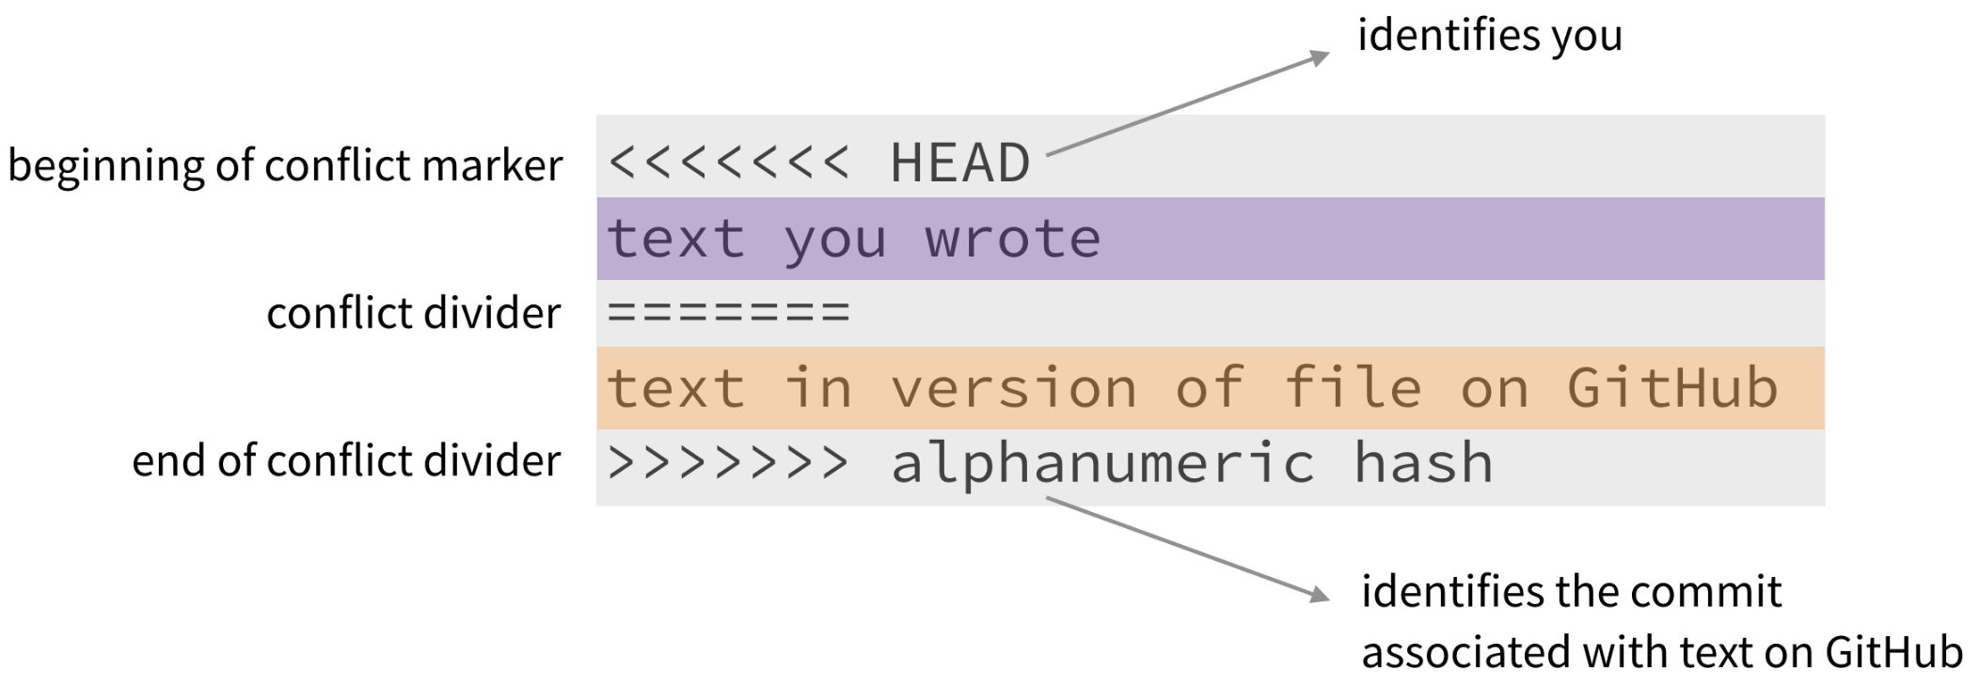
Merge Conflicts
How does a merge conflict look like?

Slide 26
Merge Conflicts
Repository on Gitlab servers
Resolve the conflict and commit the result.
Int a = 5;
Int a = 5;
Int b = 6;
Int c = 7;
test.java
git commit –m “resolve conflict ”
Int a = 5;
Int b = 6;
Int a = 5;
Int b = 6;
Int c = 1;
My Computer
test.java

Slide 27
Merge Conflicts
Repository on Gitlab servers
How to resolve merge conflicts?
Choose one of the changes and commit your conflict resolve strategy.
Int a = 5;
Int a = 5;
Int b = 6;
Int c = 1;
test.java
Int a = 5;
Int b = 6;
git push
Int a = 5;
Int b = 6;
Int c = 1;
CONFLICT RESOLVED
My Computer
test.java

Slide 28
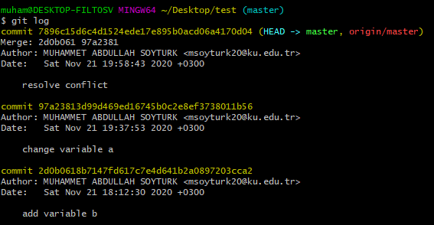
Git Commands
git log
Shows the history of commits.

Slide 29
Git Commands
git reset --hard <commit>
Reverts code back to a previous commit
int a = 5;
int a = 5;
Int b = 6
int a = 1;
Int b = 6
7896c15
97a23813
2d0b06

Slide 30
Git Commands
git reset --hard 97a23813
Reverts code back to a previous commit
int a = 5;
int a = 5;
Int b = 6
7896c15
Add a line

Slide 31
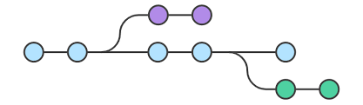
Branching
Branch is a version of the repository.
Each branch has its own commit history.

Slide 32
Branching
git branch
Shows all branches.
git branch <branch_name> to create a new branch
git checkout <branch_name> to switch to a different branch
master
int a = 5;
int a = 5
Int b = 3;
int a = 5
Int b = 3;
int a = 5
Int b = 3;
Commit 2
Commit 3
Commit 4
Commit 1
feature
int a = 5;
int a = 5;
Int d = 1
Commit 1
Commit 2

Slide 33
Branching
git merge
git merge <branch_name>
Merges current branch with <branch_name>
master
int a = 5;
int a = 5
Int b = 3;
int a = 5
Int b = 3;
Int d = 1;
Commit 2
Commit 3
Commit 1
feature
int a = 5;
int a = 5;
Int d = 1
Commit 1
Commit 2

Slide 34
Git Commands
Summary of commands
git clone <url>
git add <filename>
git commit –m “commit message”
git status
git push <remote> <branch>
git pull <remote> <branch>
git log
git reset
git branch
git merge

